Slide 1
Predicting Used Car Prices with Artificial Intelligence
PRESENTED BY:
Dhruv Datta(2210990272)
Dhruv Bansal (2201990271)
Divanshu Kaushik(2210990290)
Garvit Setia(2210990316)
UNDER SUPERVISION OF
DR. JATIN ARORA
DEPARTMENT OF COMPUTER SCIENCE AND ENGINEERING

Slide 2
INDEX
Introduction
Problem Statement
Technologies/Methods Used
Code Snapshots
Results
Conclusion
Questions
References

Slide 3
INTRODUCTION
Understanding the Market: Car prices depend on various factors like brand, model, age, mileage, and market conditions. AIML helps us analyze this complex data.
Data is King: AIML thrives on large datasets containing information on used car prices and their corresponding features.
Machine Learning Magic: We use machine learning algorithms within AIML to identify patterns between car features and their selling prices.
Prediction Power: The trained AIML model can then predict the fair market value of a car based on its specific characteristics.
Benefits for Buyers & Sellers: Both car buyers and sellers can benefit from car price prediction by getting a more informed estimate of a car's worth.
This AIML application can bring transparency and efficiency to the used car market.

Slide 4
PROBLEM STATEMENT
Inaccurate Pricing: Traditional methods of car valuation can be subjective and lack accuracy, leading to disadvantages for both buyers and sellers.
Data Rich Environment: The abundance of online car listings with detailed information presents an opportunity to leverage data for better price estimation.
Complex Feature Impact: Car prices are influenced by a multitude of factors beyond just age and mileage. Brand, model, features, and even location can play a role.
Need for Automation: The manual process of car price research is time-consuming and inefficient. An automated system can streamline price estimation.
.

Slide 5
TECHNOLOGIES/METHODS USED
Python: The project was developed using Python, a versatile programming language known for its readability and extensive libraries.
Libraries:
NumPy: Utilized for efficient numerical operations and array manipulation.
Matplotlib: Employed for creating visualisations and graphs to analyse data.
Seaborn: Used to enhance the aesthetics of visualisations and statistical data exploration.
Pandas: Utilized for data manipulation and analysis, offering powerful data structures and functions.
Scikit-learn (sklearn): Utilized for implementing machine learning algorithms, model evaluation, and preprocessing.
Machine Learning Models:
Logistic Regression: Applied for binary classification tasks, effectively identifying patterns in categorical data.
2.Gradient Boosting Trees (GBT): It use sequential decision trees to make powerful predictions by focusing on errors from previous trees.
3.Random Forest: Utilized as an ensemble learning method, constructing multiple decision trees to improve accuracy and robustness.

Slide 6
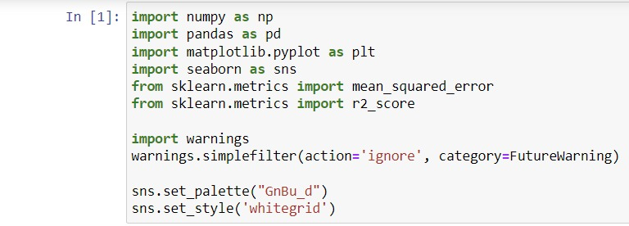
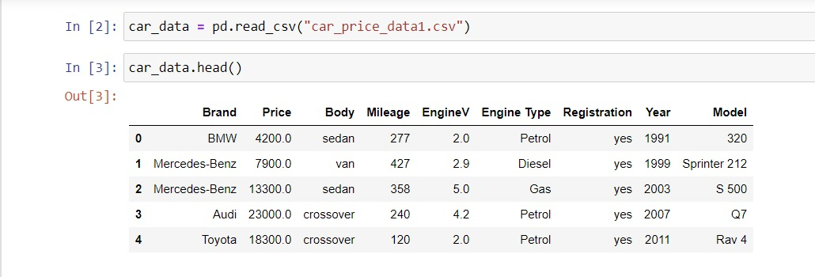
CODE SNAPSHOTS

Slide 7
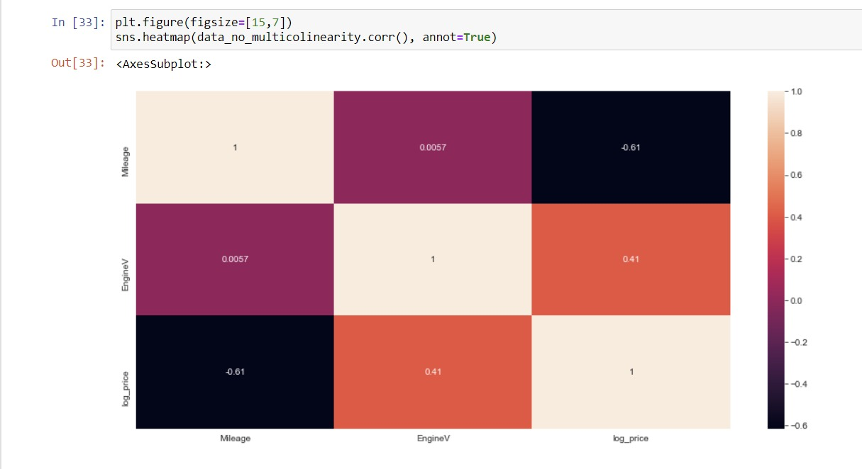
Code Snapshot
HEATMAP
Multi-Corelation;- Engine,Mileage,Engine,Log Price

Slide 8
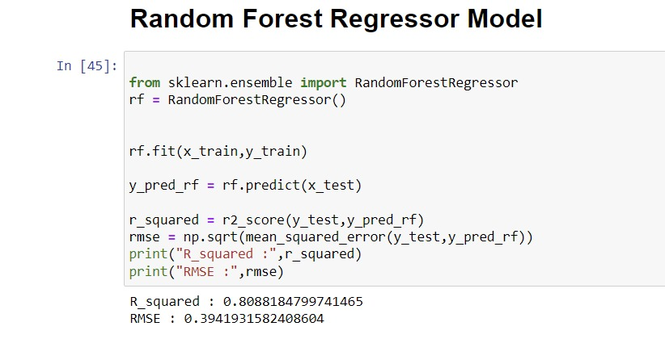
RESULT
The Random Forest Regressor output typically presents predicted values for the target variable along with feature importance scores, highlighting the relative significance of input variables in the model's predictions. Additionally, it may include evaluation metrics such as mean squared error to gauge model performance.

Slide 9
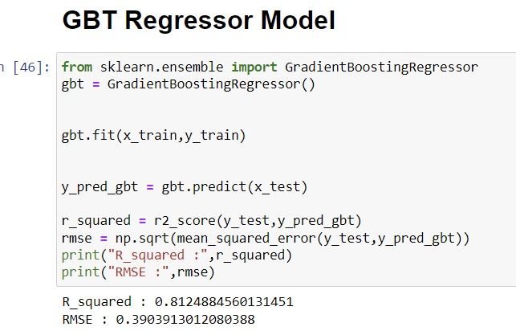
RESULT
The output of a Gradient Boosting Trees (GBT) model usually consists of predicted values for the target variable based on the learned ensemble of decision trees. It may also include feature importance scores, indicating the contribution of each input variable to the model's predictions.

Slide 10
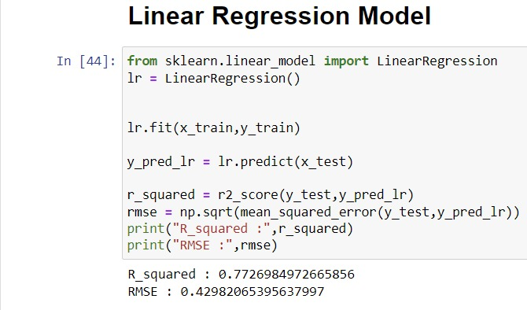
RESULT
The output typically includes coefficients and intercept, representing the relationship and baseline value, respectively. Additionally, summary statistics like R-squared offer insights into the model's goodness of fit.

Slide 11
CONCLUSION
Predicting used car prices with artificial intelligence revolutionizes the automotive industry.
Machine learning algorithms analyze historical data, market trends, and vehicle attributes for accurate valuations.
Benefits include informed purchasing decisions for buyers and competitive pricing for sellers.
AI pricing models reduce negotiation friction and enhance trust between buyers and sellers.
Real-time adaptation to market conditions improves efficiency and transparency.
Challenges like data quality and model interpretability exist but can be addressed.
Overall, AI-driven predictions offer a positive impact, revolutionizing the pre-owned car market.

Slide 12

QUESTIONS

Slide 13
REFERENCES
DATASET-https://github.com/kapilthakre/Predicting-the-Price-of-Used-Cars/blob/master/Datasets/car_price_data1.csv
NUMPY- https://www.youtube.com/watch?v=aYmcRnmZVGQ&list=PL9n0l8rSshSnragNblKDBsT8Xu3otp3jA
PANDAS- https://www.youtube.com/watch?v=oiCppYglBIU
EDA - https://www.youtube.com/watch?v=78ut-S-QOEQ&list=PLe9UEU4oeAuV7RtCbL76hca5ELO_IELk4
RANDOM FOREST-https://www.youtube.com/watch?v=3NdH3egUjpM&list=PLBSCvBlTOLa8Xp1tjW0C3So94zhDbTTvh
Gradient-Boosted Trees - https://www.youtube.com/watch?v=3CC4N4z3GJc

Slide 14

THANK YOU!

